Slide 1
Hypolipidemic drugs
Shaymaa F. Abbas
Pharmacology Department
24 SLIDES

Slide 2
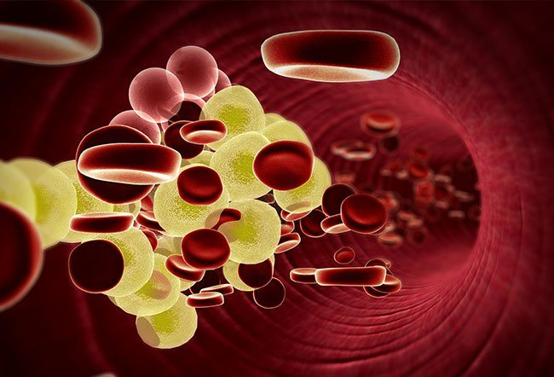
Learning objectives
Clinical significance of hyperlipidemia
Management of hyperlipidemia
Drugs used in hyperlipidemia

Slide 3
Two main types of Lipids are triglycerides and cholesterol
To be carried in plasma, they need to be coated by special proteins to form complexes termed as LIPOPROTEINS
There are 3 main types of plasma lipoprotein:
VLDL-pre beta-lipoprotein: TG rich
LDL- beta- Lipoprotein( bad cholesterol): cholesterol rich
HDL-alpha-lipoprotein (good cholesterol)

Slide 4
VLDL carries TG from the liver to the peripheral tissues
LDL carries cholesterol from the liver to the peripheral tissue and removed from circulation by liver LDL receptors
Cholesterol within cells is needed for membrane synthesis and repair, in liver is needed to form bile acid.
Excess LDL, VLDL----risk of atherosclerosis and IHD
HDL takes cholesterol from peripheral cells to the liver
Excess HDL------protective against atherosclerosis and IHD
(IHD=ischemic heart diseases)

Slide 5
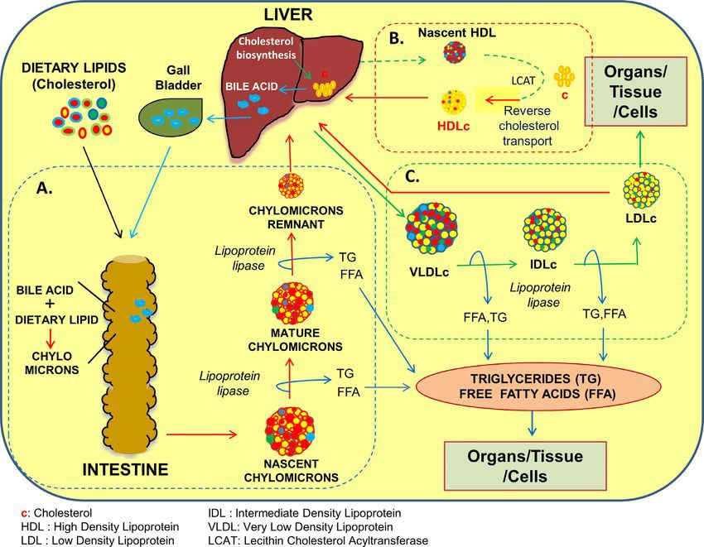

Slide 6
Management of hyperlipidemia
Long term decisions on management should be initiated only on the basis at least two fasting blood samples.
Management may proceed as follows:
Any medical disorder that may be causing hyperlipidemia should be treated first.
Dietary adjustment
Exercise and weight management
Drugs

Slide 7
Statins
Mechanism of action
The statins are competitively inhibit the rate-limiting enzyme in hepatic cholesterol synthesis, hydroxyl methyl glutaryl coenzyme A (HMG-CoA) reductase
This lead to decrease hepatic cholesterol synthesis, so as compensatory mechanism there will be increased synthesis of LDL receptors (up-regulation) in the liver and increased clearance of LDL from circulation

Slide 8
Plasma total cholesterol and LDL cholesterol fall
Maximum effect after 1 month of therapy.
These drugs also reduce triglycerides and increase HDL cholesterol

Slide 9
HMG-CoA reductase inhibitors also have direct anti-atherosclerotic effects and anti-inflammatory effects (stabilize atheroma)---reduce the risk of cardiovascular events in patients with coronary artery disease.
It has become standard practice to initiate statin therapy immediately after acute coronary syndrome, regardless of lipid levels

Slide 10
Statins are well absorbed after oral administration, and are metabolized in liver.
Statins are given by mouth at night to decrease peak cholesterol synthesis in early morning.
Ex: Rosuvastatin, atorvastatin, and simvastatin

Slide 11
Adverse effects
They are well tolerated
GIT: Dyspepsia, flatulence, constipation, abdominal pain
Minor abnormality of liver function tests
Asymptomatic elevation of muscle enzymes, myalgia, myositis, rhabdomyolysis occurs rarely.
Risk factors for rhabdomyolysis: renal insufficiency, vitamin D deficiency, hypothyroidism, advanced age, and use of drugs that increase the risk of muscle adverse effects (azole antifungals, erythromycin, gemfibrozil)

Slide 12
FIBRIC ACID DERIVATIVES (Fibrates)
e.g. gembfibrozil, fenofibrate
These drugs increase activity of lipoprotein lipase, the enzyme that breakdown TG into free fatty acids
In muscle vascular bed the activity of lipoprotein lipase and fatty acid uptake and oxidation are increased
Also increase oxidation of fatty acids in liver so decrease hepatic TG synthesis
So plasma total TG and VLDL decreases
There is also rise in protective HDL-cholesterol

Slide 13
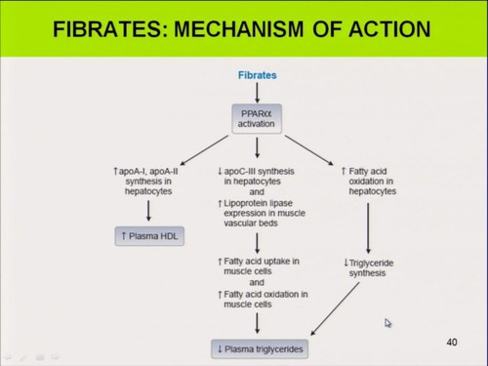

Slide 14
They are drugs of choice for hypertriglyceridemia (elevated VLDL), but may be used in hypercholesterolemia, with anion exchange resins or statins (with care)
Fenofiberate has mild uricose-uric effect

Slide 15
Adverse effects
GIT disturbances (nausea, abdominal pain, diarrhea)
Gall stone formation
Hepatotoxicity
Rarely myositis( should be used cautiously with statins)
Fibrates should not be used in patients with severe hepatic or renal dysfunction, in patients with preexisting gallbladder disease or biliary cirrhosis.

Slide 16
ANION EXCHANGE RESINS (Bile acid sequestrants)
Cholestyramine
Acts by binding bile acids in intestine, so inhibits the re-absorption of bile salts into their enterohepatic cycle, so bile acids are lost in feces.
The depletion of bile acid pool will stimulate conversion of cholesterol to bile acids, thereby reducing the amount of cholesterol in the liver.
A compensatory increase in the synthesis of hepatic LDL receptors increases the removal of LDL cholesterol from the blood.( decrease plasma LDL)

Slide 17
Uses
Hypercholesterolemia but not hypertriglyceridemia
Relieves pruritus caused by accumulation of bile acids in patients with partial biliary obstruction.

Slide 18
Adverse effects
GIT side effects including constipation, abdominal fullness, anorexia and occasionally diarrhea.
Absorption of vitamins (eg, vitamin K, dietary folates) and drugs (eg, thiazide diuretics, warfarin, pravastatin, digoxin, thyroxine) is impaired by the resins
These agents may raise TG levels and are contra-indicated in patients with significant hypertriglyceridemia (greater than 400 mg/dL).

Slide 19
NICOTINIC ACID DERIVATIVES
(Niacin or vitamin B3)
Inhibits lipolysis in adipose tissue, reducing the availability of free fatty acids which are substrate for hepatic TG synthesis so decrease VLDL
So it lowers plasma TG and cholesterol concentrations and raises HDL-cholesterol.(most potent drug that increase HDL)
Is used in all types of hyperlipidemia, usually in combination with other
Oral dose is 100 times more than normal human nutritional needs.

Slide 20
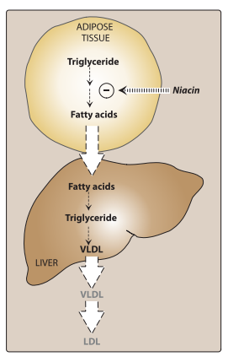

Slide 21
Adverse effects
GIT upset: nausea, dyspepsia, abdominal pain, diarrhea
Pruritus and flushing of face, neck and ears(PGs mediated)
Hepatotoxicity
Gouty arthritis and hyperglycemia
Its use is limited because of unpleasant side effects

Slide 22
Ezetimibe (Ezetrol)
Selectively blocks intestinal absorption of cholesterol
By preventing absorption of dietary cholesterol and cholesterol that is excreted in bile, ezetimibe reduces the cholesterol in the liver
A compensatory increase in the synthesis of hepatic LDL receptors increases the removal of LDL cholesterol from the blood.
It deceases LDL primarily , with mild reduction in TG and increase in HDL

Slide 23
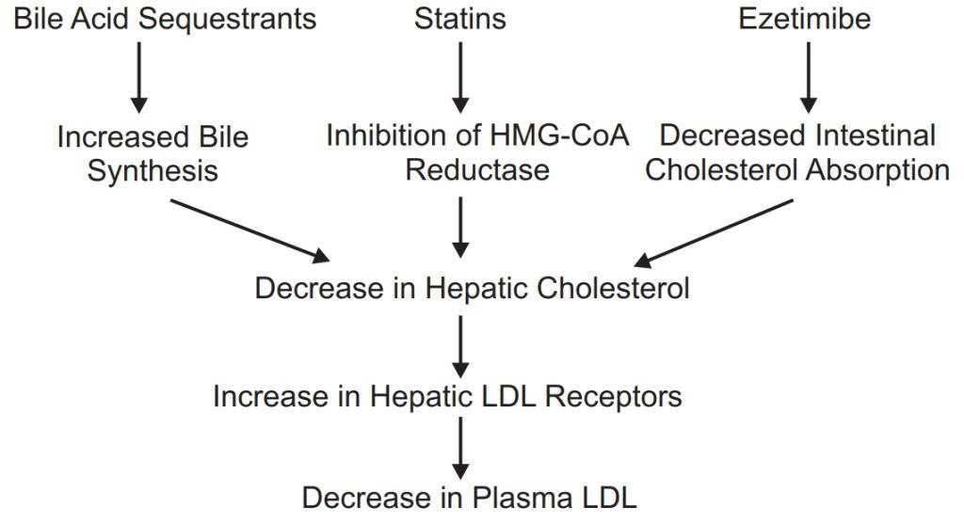
As a compensatory mechanism for loss of bile acids in feces

Slide 24
OTHER DRUGS
Omega -3
Omega-3 polyunsaturated fatty acids (PUFAs) are essential fatty acids that are predominately used for triglyceride lowering.
Essential fatty acids inhibit VLDL and triglyceride synthesis in the liver.
The omega-3 PUFAs are found in marine sources such as tuna, halibut, and salmon.
They have small effect LDL-C and HDL-C.

Slide 25
A 65-year-old man has type 2 diabetes mellitus and an LDL -C of 165 mg/dl. Which is the best option to lower LDL-C and decrease the risk of CVD events in this patient?
A. Fenofibrate
B. Colesevelam
C. Rosuvastatin
D. Ezetimibe

Slide 26
A 62-year-old female with hyperlipidemia and hypothyroidism is prescribed cholestyramine and levothyroxine (thyroid hormone). What advice would you give this patient to avoid a drug interaction between her cholestyramine and levothyroxine?
Stop taking the levothyroxine as it can interact with cholestyramine.
Take levothyroxine 1 hour before cholestyramine on an empty stomach.
Switch cholestyramine to colesevelam as this eliminates the interaction.
Switch cholestyramine to colestipol as this eliminates the interaction.

Slide 27
A 42-year-old man was started on sustained-release niacin 2 weeks ago. He reports uncomfortable flushing and itchiness that he thinks is related to the niacin. Which of the following can help manage this adverse effect of niacin therapy?
Administer aspirin 30 minutes prior to taking niacin.
Administer aspirin 30 minutes after taking niacin.
C. Increase the dose of niacin.
D. Change the sustained-release niacin to immediate release niacin

Slide 28
A 42-year-old man was started on sustained-release niacin 2 weeks ago. He reports uncomfortable flushing and itchiness that he thinks is related to the niacin. Which of the following can help manage this adverse effect of niacin therapy?
Administer aspirin 30 minutes prior to taking niacin.
Administer aspirin 30 minutes after taking niacin.
C. Increase the dose of niacin.
D. Change the sustained-release niacin to immediate release niacin

Slide 29
A 72-year-old man with hyperlipidemia and renal insufficiency has been treated with atorvastatin for 6 months. His LDL-C is 131 mg/dl; triglycerides, 710 mg/dl (n =180 mg/dl); and HDL-C, 32 mg/dl. His physician wishes to add another agent for hyperlipidemia. Which is the best option to address the hyperlipidemia in this patient?
Fenofibrate
Niacin
Colestipol
Gemfibrozil

Slide 30
Which patient population is most likely to experience myalgia (muscle pain) or myopathy with use of HMG CoA reductase inhibitors?
A. Patients with renal insufficiency
B. Patients with gout
C. Patients with hypertriglyceridemia
D. Patients taking warfarin (blood thinner)

Slide 31


